Slide 1

Workout Logger
Submitted by: Ayush Tuladhar
Bsc. CSIT IV
Subject: Java

Slide 2
Introduction
Digital logging of workouts
Built with Java Swing, JDBC, MySQL (XAMPP/SQLyog)
Benefits: Accuracy, time-saving, structured progress tracking
Scalable for future features (AI, mobile, visualization)

Slide 3
Problem Statement
Manual logs are inconsistent, hard to analyse, and prone to loss
Digital solution improves consistency, searchability, and motivation

Slide 4
Objectives
Log exercises with sets, reps, weights, and rest time
Provide searchable workout history
Secure MySQL data storage
Extendable for future features

Slide 5
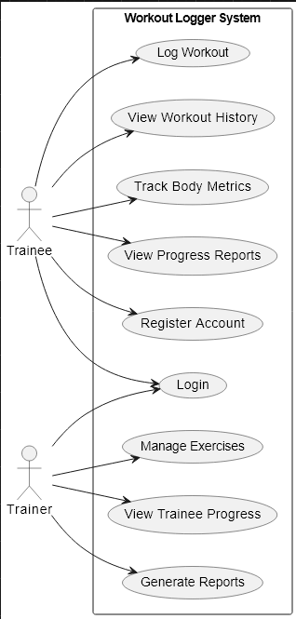
Use Case Diagram
Trainee – can log workouts, view history, track body metrics, view progress reports, register an account, and log in
Trainer – can manage exercises, view trainee progress, and generate reports

Slide 6
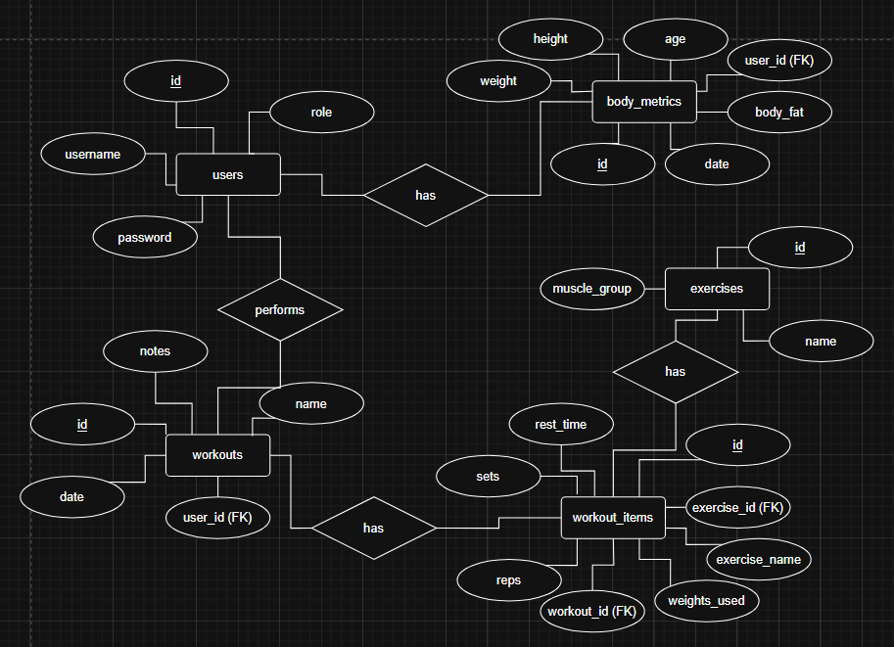
ER Diagram
Users – stores login credentials and roles (trainee or trainer)
Body Metrics – records measurements like height, weight, age, and body fat linked to a user
Workouts – stores workout sessions performed by users, linked to workout items
Exercises – catalogue of available exercises, grouped by muscle group
Workout Items – details of each exercise in a workout, including sets, reps, rest time, and weights used

Slide 7
Future Implementation
Graphical progress charts
Mobile app integration
Cloud deployment
AI-driven recommendations
Wearable device integration

Slide 8
Future Implementation
Reliable, user-friendly digital tool for fitness tracking
Reduces errors and improves workout management

Slide 9
THANK YOU

